Slide 1
Neural chatbots for official statistics
By vamsi Krishna varma Gunturi (1794653)

Slide 2
introduction
Before going to discuss about the applications of chatbots and specifically chatbots using neural networks, let us analyse the following questions:
What is a chat bot and what are its use cases ?
What is deep learning and how is it different from traditional machine learning ?

Slide 3
What are chatbots ?
A chatbot is a program that can conduct an intelligent conversation to convincingly simulate human behaviour and pass the Turing test.
What is Turing test ?
Developed by scientist Alan Turing in 1950, the Turing test basically says that, if you can interact or have a conversation with a bot and be unable to distinguish between a bots responses and the responses of an actual human being, then that bot has passed the Turing test.

Slide 4
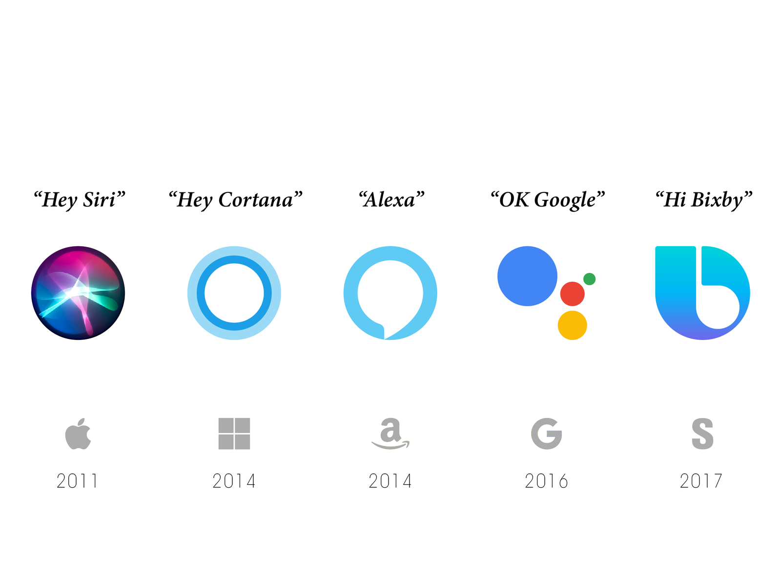
Chatbots are everywhere

Slide 5
Where would you use chatbots and why should one use chatbots?
Where ?
Help navigating a site
Customer support for your order
Improve your brand and user experience seamlessly
Why ?
They are autonomous and available 24/7
They are fast
They drive conversations
They are relevant

Slide 6
Types of chatbots
There are mainly 2 types of chatbots:
Rule based bots
Example: Chatfuel , Manychat, Facebook Itsalive etc..,
AI based chatbots
Example: Google Dialogflow, IBM Watson etc..,

Slide 7
Rule based chatbots
Basic chatbots
Know only about rules that they are pre-programmed with(bunch of if-else statements)
Static
Cannot learn

Slide 8
AI based chatbots
Intelligent, can learn from previous conversations using machine learning techniques
Dynamic
Learn from human conversations in the past and there by getting better over time
In other words, the AI based bot figures out intent of human conversation using Natural language processing and other techniques

Slide 9
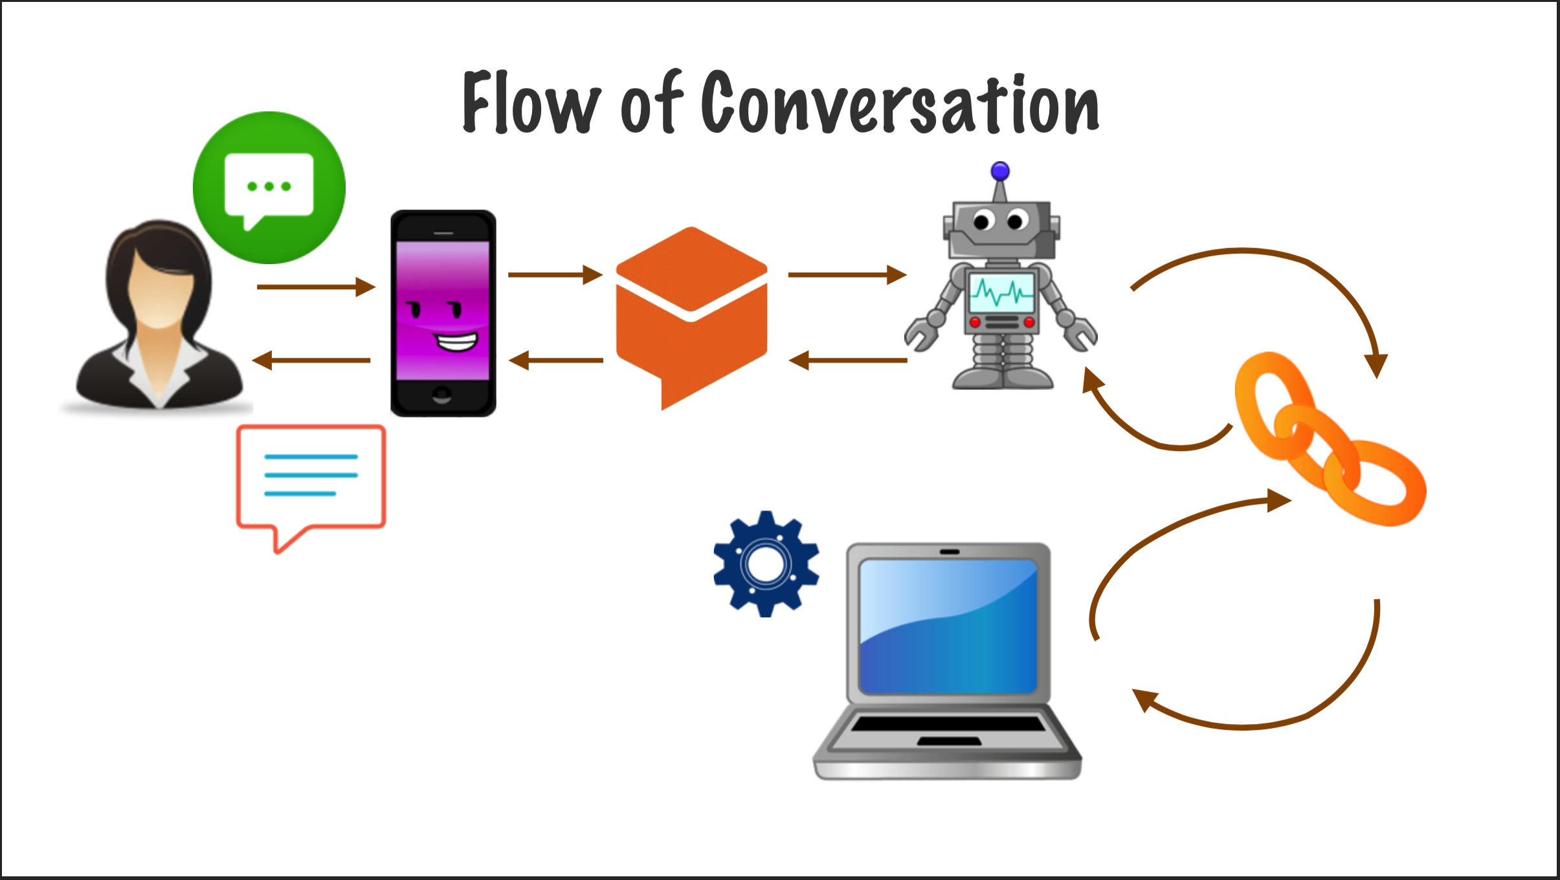
Typical workflow of AI bot

Slide 10
AI BOT workflow
Input – User types in a message (User expressions) through an user interface like Slack, Google Assistant, Facebook messenger etc..,
Agent – Then the control flow passes to an agent which is a module which incorporates natural language processing to understand what user meant and transforms user requests to actionable data
Intent - Then the agent maps the user requests to an intent and then the intent determines action taken by the code

Slide 11
AI BOT workflow (continued..)
Fulfilment – The code executes to fulfil the intent of the user
Response – The response in the form of a text message is sent back to the user

Slide 12
What is deep learning ?
Deep learning is an artificial intelligence function that aims to imitate the main functions of human brain. A deep learning model firstly processes data, creates and identifies patterns and finally uses these in decision-making process.
Deep learning stands out from traditional machine learning since its networks are capable of learning from unstructured and unlabelled data in an unsupervised way.

Slide 13
Deep learning mechanisms
Artificial neural networks (ANNs)
Convolutional neural networks (CNNs)
Recurring neural networks (RNNs)
Boltzmann machines (BM)
Long short term memory (LSTM)
Generative adversarial networks (GANs)

Slide 14
Applications of Deep learning
Image recognition. Example: Google deep dream
Computer vision. Example: Face detection, Facebook automatic tagging
Natural language processing. Example: Google translate
Pattern recognition. Example: GAN’s like Creating essays, writing poems and generating artwork, Fake videos etc..,
Speech recognition. Example: Google Assistant, Amazon Echo, Apple Siri etc..,

Slide 15
CHATBOT Demos

Slide 16
Types of bots analysed
In this work, 5 types of chatbots are analysed based on the level of complexity of implementation –
Basic rule based chatbot using chat fuel (No machine learning involved just web scrapping)
Intermediate bot using IBM Watson for driverless cars and training the bot using training data supplied as an external json file (Supervised learning)
Intermediate bot using Google DialogFlow to get weather of a city on a particular day using openweathermap website. (Supervised learning)
LSTM based Deep learning chatbot using Google DialogFlow to forecast the stock price of a particular company. (Semi Supervised learning)
Pure deep learning bot using LSTM model which is trained using movie dialogues from over 600 movies to generate responses on the fly (Unsupervised learning)

Slide 17
Interactive BOT Using chat fuel
Lets start the demonstrations with basic chat bot created using chat bot generation platform chat fuel. Initially this rule based bot is configured using data scrapped from external e-commerce site Farm-r which is a farmer-to-farmer rental market place.
The data scrapped from this site is stored in a Heroku webserver hosting platform to expose the api’s based on the request from the chat bot. Basically the data on the site is grouped as categories and sub-categories. So the chatbot will fetch this information dynamically from the apis and displays it to the user. Based on the user selections, we will display the products that fall under that specific category and subcategory. So this is basically a website with in Facebook messenger platform.
The bot can be accessed by any one who has messenger access with this link

Slide 18
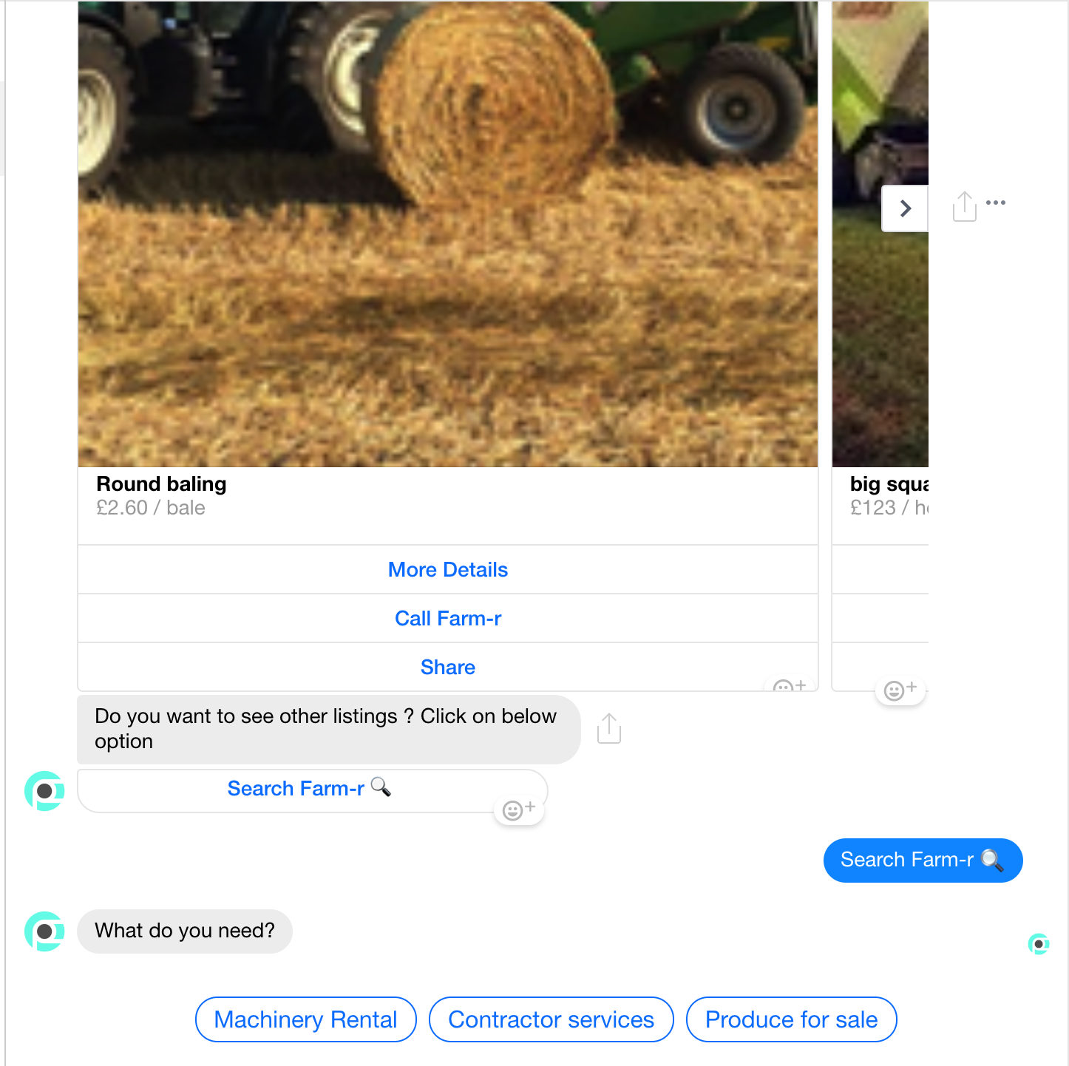
Interactive BOT Using chat fuel (CONT..)

Slide 19
Driverless car bot using IBM Watson
This is supervised chat bot which can be automatically trained to new behaviours through an external json file or manually creating the agents, intents, entities and fulfilments (as per the already mentioned chatbot workflow)
This bot helps user of a driverless car by performing a host of operations like turning on/off AC, lights, music, radio, finding the nearest gas station and restrooms (of course with the help of external GPS api’s).
To create this bot we need to configure the IBM Watson console and create different configurations to set up the bot.
Third party integrations like Slack and Facebook messenger are also supported. So we can integrate this bot in to our existing apps.
This bot can be accessed through Facebook messenger using this link. It is also deployed on slack on this workspace. If you login to this workspace(using the invite email) you can see the bots integrated in the Apps section. The bot name is watson-dl-bot.

Slide 20
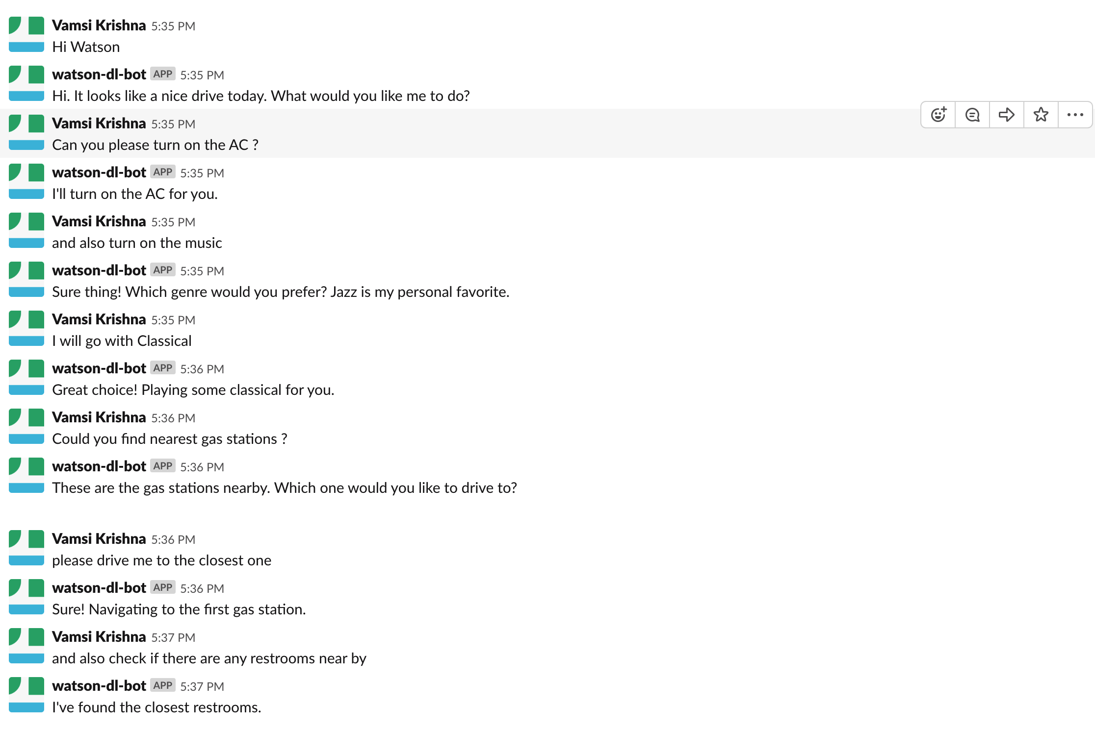
Driverless CAR bot using IBM Watson (CONT..)

Slide 21
Weather forecast bot using Google dialog flow
This is a supervised chat bot which can automatically fetch weather data of a city on a particular day using openweathermap open api’s.
This bot is created using Google Dialogflow and it performs different operations like small talk, book rooms, cars for a particular date and finally gets the weather data of a particular city on a specified date .
To create this bot we need to configure the Google Dialog flow console and create different configurations like entities, intents, events etc.., to set up the bot.
This bot has been deployed on slack on this workspace. If you login to this workspace(using the invite email) you can see the bots integrated in the Apps section. The bot name is dialogflow-bot.
Code for the webhook is available here

Slide 22
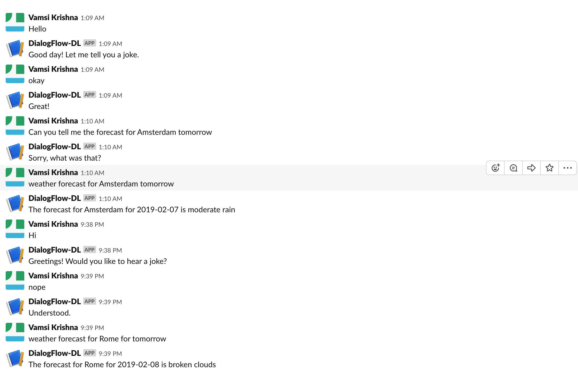
Weather forecast bot using Google dialog flow (CONT..)

Slide 23
Stock predictor bot using LSTM
This is a supervised chat bot which relies heavily on LSTM deep learning model using Keras for stock price prediction.
Stock data downloaded from Yahoo finance website is used for training LSTM models. Primarily data from 10 companies (Alibaba, Amazon, Apple, Dell, Google, Facebook, Microsoft, Tesla, Twitter and Wallmart) has been considered for the prediction bot. Once training is done for each company, the models generated are deployed on to Heroku server to make the requests from outside.
When a user provides a company name and a date, the parameters are passed to the LSTM model to run the prediction algorithm which outputs the predicted value as well the actual value, error and error rate information back to the user. Example output would be “ The predicted stock price of Tesla on 2019-02-07 is 282.64 and actual value is 315.3 with error and error rate as -32.66 and 10.36”.
This bot is integrated with slack and the name of the bot is Dialogflow Bot.
Code for the deep learning model is available here

Slide 24
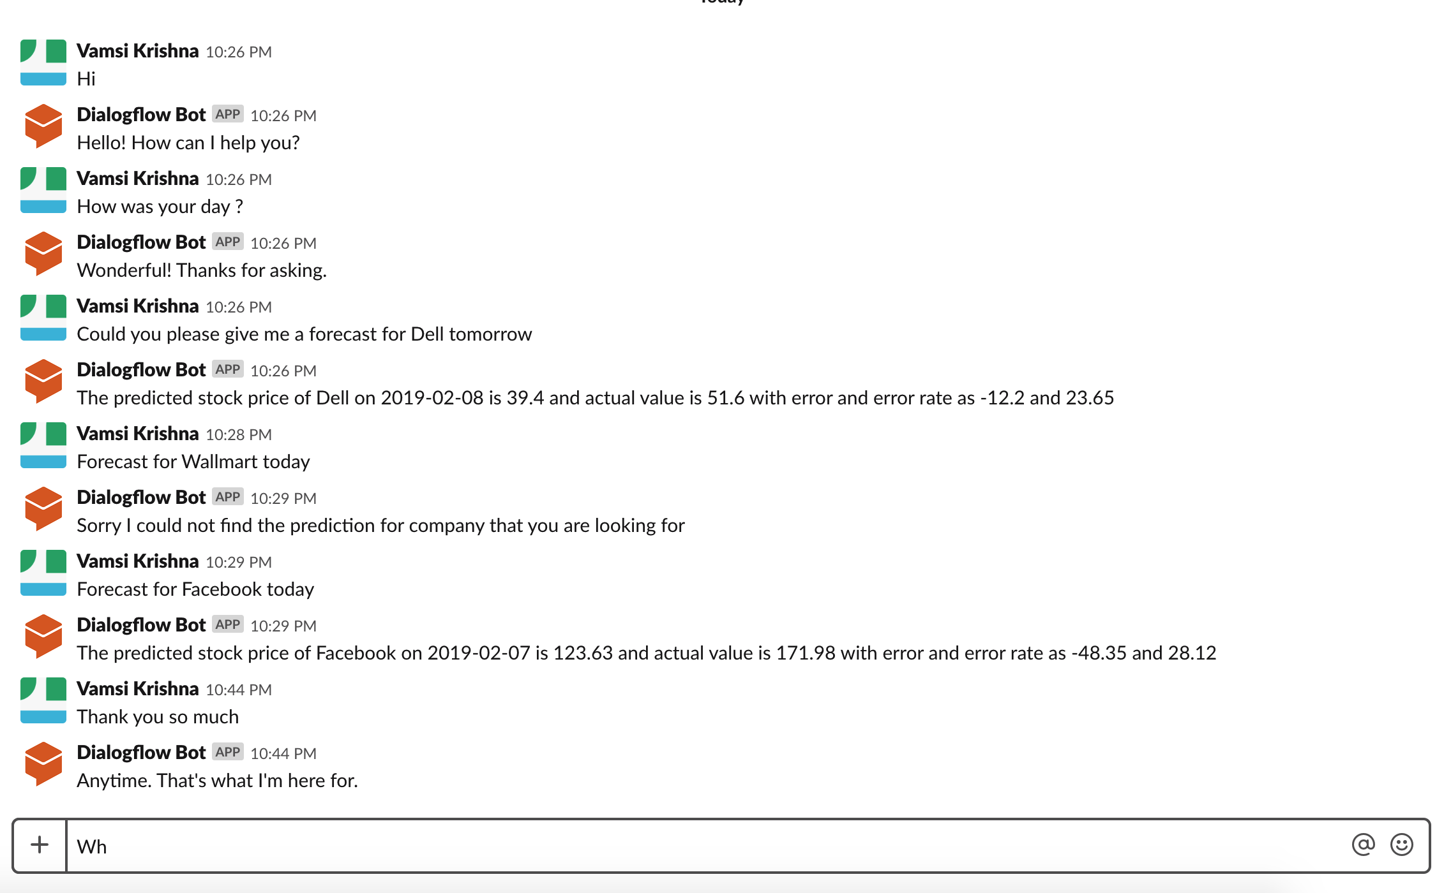
Stock predictor bot using LSTM (Cont…)

Slide 25
Unsupervised Chatbot with deep nlp
This is the final bot that was analysed. This bot makes use of sequence to sequence deep learning architecture using TensorFlow which is one of the best deep learning frameworks.
Cornell movie corpus dataset has been used to train our deep NLP bot. This dataset contains data of more than 600 movies and thousands of conversations.
The analysis involves 4 steps namely data pre-processing, building, training and testing seq2seq model.
This analysis is a work in progress so not many results to display.

Slide 26
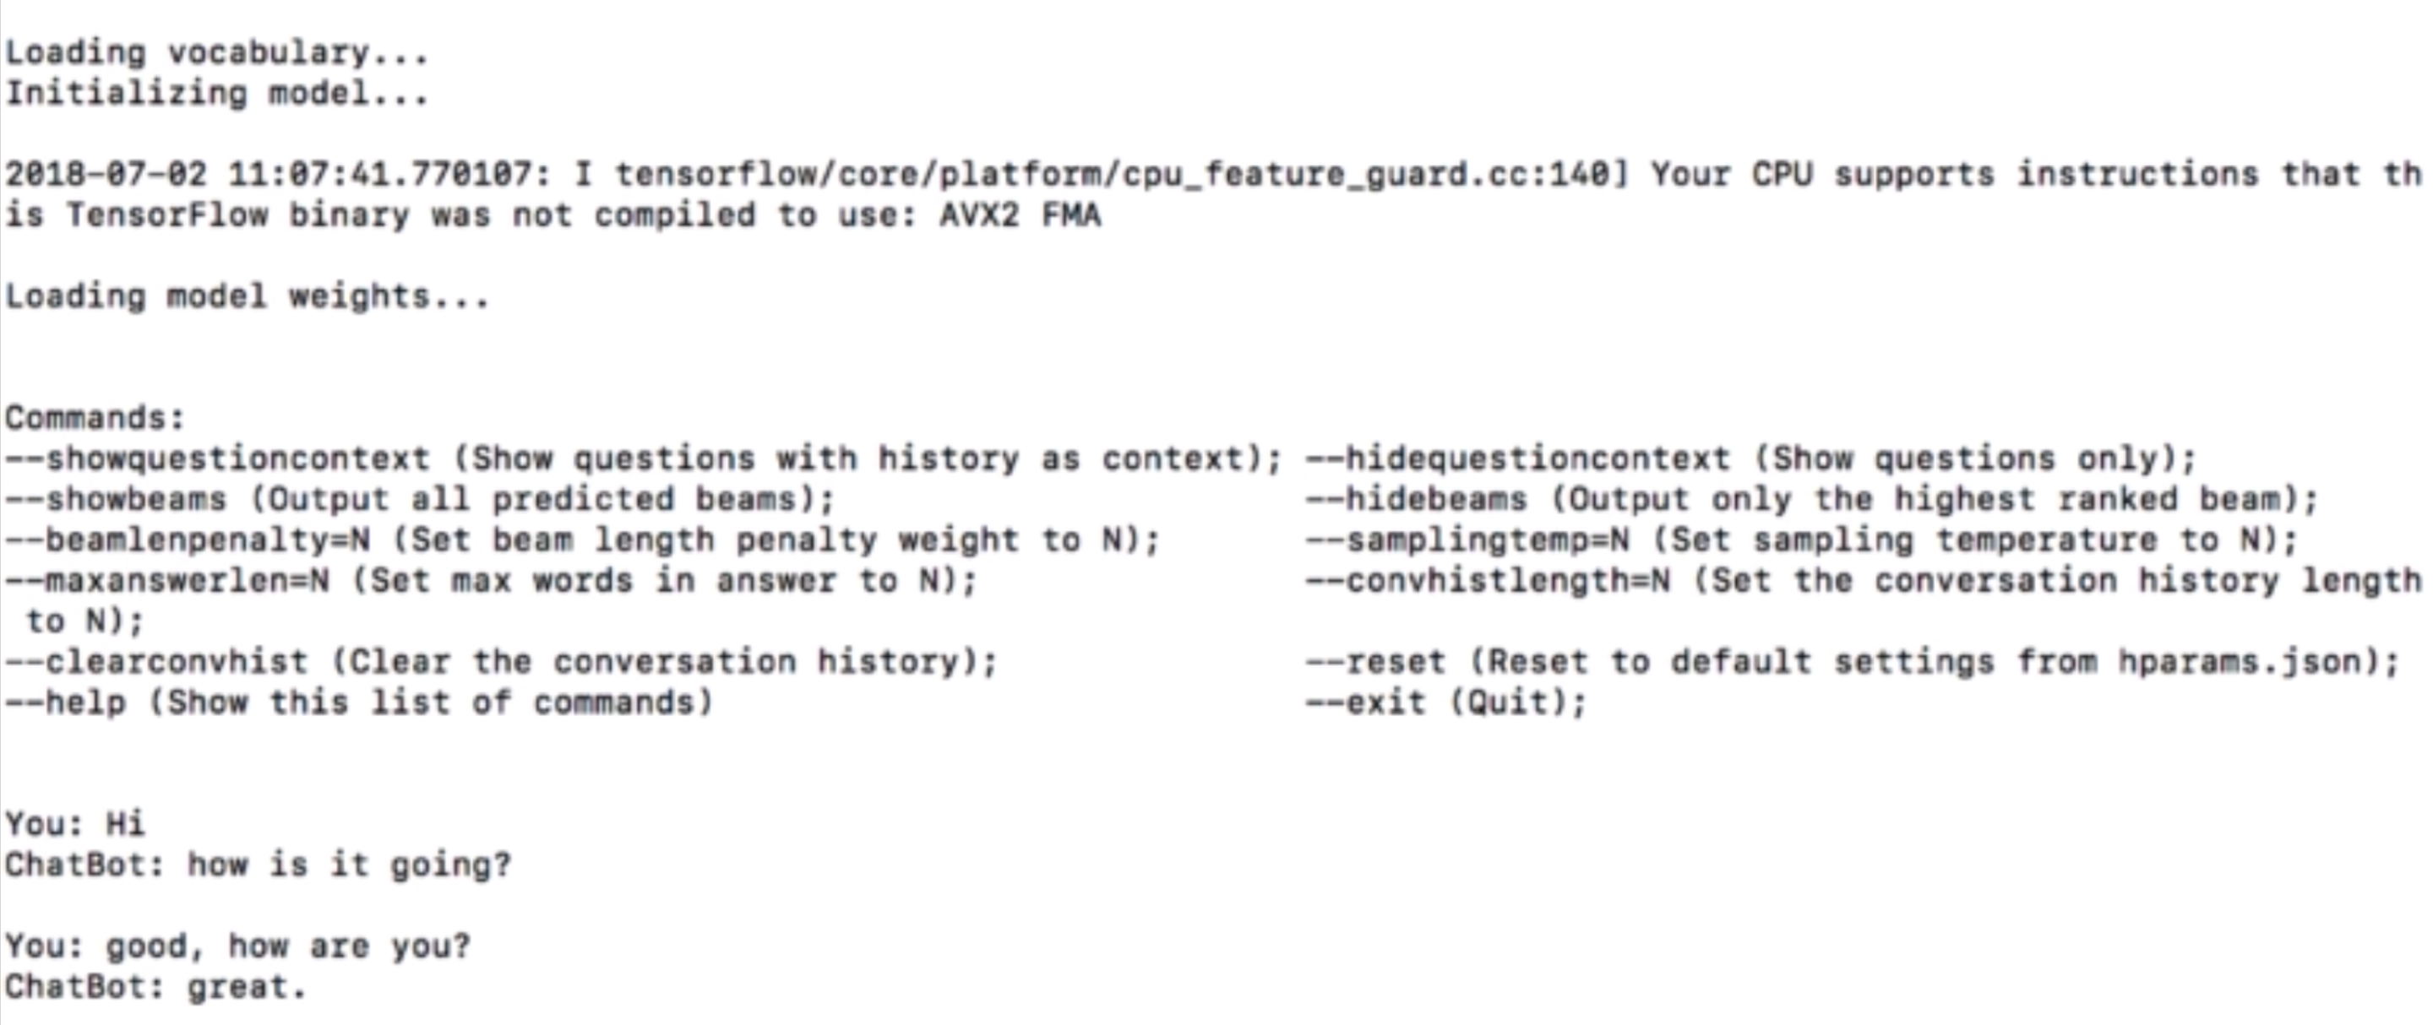
Unsupervised Chatbot with deep nlp(CONT…)

Slide 27
Thank YOU

